Slide 1
Organizational Culture

Slide 2
Organizational Culture
Institutionalization: A forerunner of culture
When an organization takes on a life of its own, apart from any of its members, becomes valued for itself, and acquires immortality
Organizational Culture
A common perception held by the organization’s members; a system of shared meaning
Seven primary characteristics capture the essence of an organization’s culture”
Innovation & Risk-Taking
Attention to detail
Outcome orientation
People/ Customer orientation
Collaboration/Team orientation
Aggressiveness
Stability

Slide 3
Culture Framework: Findings on Dimensions of Focus & Flexibility/ Stability( Quinn & Cameron)
Organizations are also grouped into one of the four types,The differences in these four cultures are identified through
Internal & External Focus
Flexibility & Stability
The Clan ( Doing things together)
Culture based on Human Affiliation.
Employees value Attachment, collaboration , trust and support
Internally focused and flexible
The Adhocracy (Doing things first)
Culture based on Change
Employees value growth, variety, Attention to detail, stimulation & autonomy
Externally Focused & Flexible
The Market (Getting the job done)
Culture based on Achievement
Employees value communication, competence and competition
Externally Focused & Stable
The Hierarchy ( Doing things right)
Culture based on Stability
Employees value communication, formalization and routine
Internally focused & stable

Slide 4
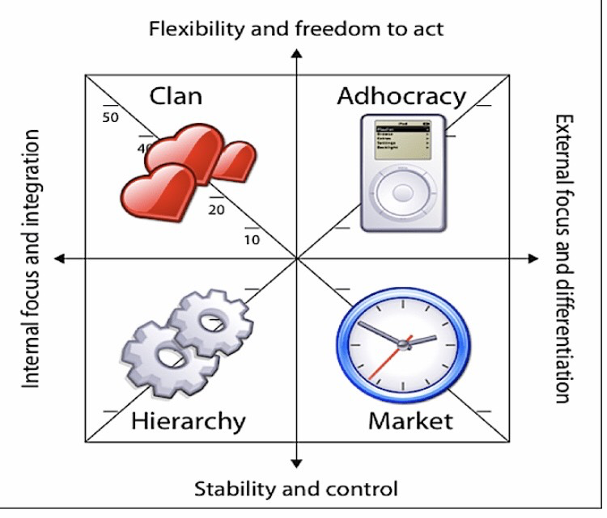
Cultural Framework Diagram
M A C H ( Quinn & Cameron)

Slide 5
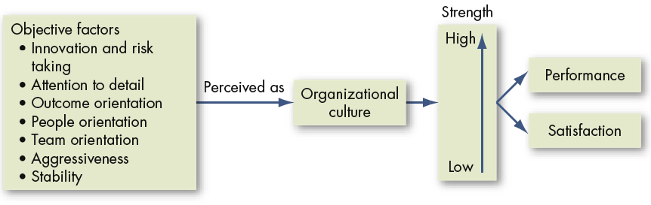
Culture as an Intervening Variable In EMPLOYEE performance and satisfaction
Employees form an overall subjective perception of the organization based on these objective factors:
The opinions formed affect employee performance and satisfaction.
Notes:
It is important to keep in mind that employees will form a perception of the organization based on things they observe. These opinions will affect their performance and job satisfaction so it is important to pay attention to organizational culture and its impact on employee outcomes.
(c) 2008 Prentice-Hall, All rights reserved.

Slide 6
Do Organizations Have Uniform Cultures?
Culture is a descriptive term: It describes an organization just as personality traits define employees.
It may act as a substitute for formalization
Dominant Culture
Expresses the core values that are shared by a majority of the organization’s members
Subcultures
Minicultures within an organization, typically defined by department designations and geographical separation
Core Values
The primary or dominant values that are accepted throughout the organization
Strong Culture
A culture in which the core values are intensely held and widely shared

Slide 7
What Do Cultures Do?
Culture’s Functions
Defines the boundary between one organization and others
Conveys a sense of identity for its members
Facilitates the generation of commitment to something larger than self-interest
Enhances the stability of the social system
Serves as a control mechanism for fitting employees in the organization

Slide 8
Culture as an Asset (Something Value)
Organization can provide a positive ethical environment and foster innovation.
Start-up firms usually have innovative cultures because they are usually small, agile and focused on solving problems to survive and grow.

Slide 9
Culture as a Liability (Debt)
Barrier to change
Occurs when culture’s values are not aligned with the values necessary for rapid change
Organization undergoing rapid change and its culture may no longer be appropriate
Barrier to diversity
Strong cultures put considerable pressure on employees to conform, which may lead to institutionalized bias
Employees who wish to fill in and adapt must accept the org core culture
Barrier to acquisitions and mergers
Incompatible cultures( lacking commonality of goals) can destroy an otherwise successful merger
Initially, the merger and acquisition decisions were based on potential financial advantage and product synergy. In recent years, cultural compatibility has become the prime concern.

Slide 10
How Culture Begins
Stems from the actions of the founders:
Founders hire and keep only employees who think and feel the same way they do.
Founders indoctrinate and socialize these employees to their way of thinking and feeling.
The founders’ own behavior acts as a role model that encourages employees to identify with them and thereby internalize their beliefs, values, and assumptions.

Slide 11
Keeping Culture Alive
Selection
Founders hire and keep only employees who think and feel the same way they do.
Provides information to candidates about the organization
Top Management
Senior executives help establish behavioral norms that are adopted by the organization
Socialization
The process that helps new employees adapt to the organization’s culture

Slide 12
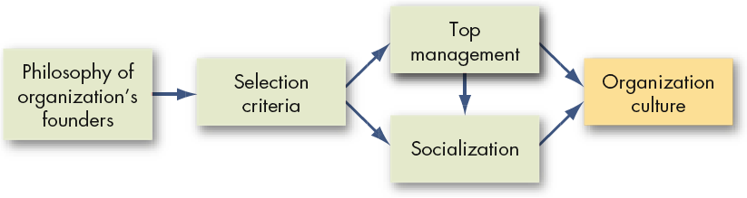
How Organizational Cultures Form
Organizational cultures are derived from the founder
They are sustained through managerial action

Slide 13
Stages in the Socialization Process
Prearrival
The period of learning prior to a new employee joining the organization
Encounter
When the new employee sees what the organization is really like and confronts the possibility that expectations and reality may diverge
Metamorphosis
When the new employee changes and adjusts to the work, work group, and organization

Slide 14
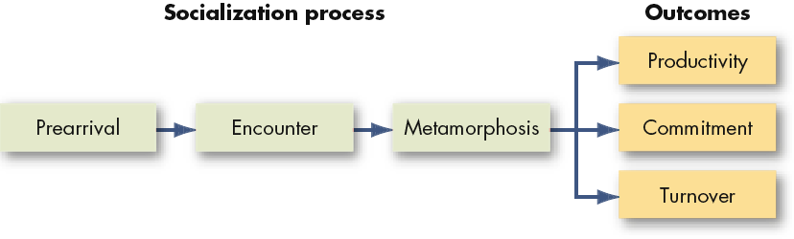
Socialization Process

Slide 15
How Employees Learn Culture
Stories
Anchor the present into the past and provide explanations and legitimacy for current practices
Rituals
Repetitive sequences of activities that express and reinforce the key values of the organization
Material Symbols
Acceptable attire, office size, opulence of the office furnishings, and executive perks that convey to employees who is important in the organization
Language
Jargon and special ways of expressing one’s self to indicate membership in the organization

Slide 16
Creating a Positive Organizational Culture
Positive Organizational Culture
A culture that:
Builds on employee strengths
Focus is on discovering, sharing, and building on the strengths of individual employees
Rewards more than it punishes
Articulating praise and “catching employees doing something right”
Emphasizes individual vitality and growth
Helping employees learn and grow in their jobs and careers
Limits of Positive Culture:
May not work for all organizations or everyone within them

Slide 17
Spirituality and Organizational Culture
Workplace Spirituality
The recognition that people have an inner life that nourishes and is nourished by meaningful work that takes place in the context of the community
NOT about organized religious practices
People seek to find meaning and purpose in their work.

Slide 18
Why Spirituality Now?
As a counterbalance to the pressures and stress of a turbulent pace of life and the lack of community( due to contemporary lifestyles-single parent families, geographic mobility, temporary nature of jobs, new technologies that create distance between people) which many feel and perceive increase the need for involvement and connection.
Formalized religion hasn’t worked for many people.
Job demands have made the workplace dominant in many people’s lives, yet they continue to question the meaning of work.
The desire to integrate personal life values with one’s professional life.
An increasing number of people are finding that the pursuit of more material acquisitions leaves them unfulfilled.

Slide 19
Characteristics of a Spiritual Organization
Concerned with helping people develop and reach their full potential
Directly addresses problems created by work/life conflicts
Four characteristics of spiritual organizations:
Strong sense of purpose
Trust and respect
Humanistic work practices ( Benevolence)
Toleration of employee expression

Slide 20
Criticisms of Spirituality
What is the scientific foundation?
It is still pending: needs more research
Are spiritual organizations legitimate: do they have the right to impose values on employees?
Spirituality is not about God or any religious values
It is an attempt to help employees find meaning and value in their work
Are spirituality and profits compatible?
Initial evidence suggests that they are
Spirituality is positively related to creativity, employee satisfaction, job involvement and organizational commitment and may result in greater productivity and dramatically lower turnover

Slide 21
Summary and Managerial Implications
Strong cultures are difficult for managers to change
In the short run, strong cultures should be considered fixed
Selecting new hires that fit well in the organizational culture is critical for motivation, job satisfaction, commitment, and turnover
Socialization into the corporate culture is important
As a manager, your actions as a role model help create the cultural values of ethics, spirituality, and a positive culture

